Slide 1
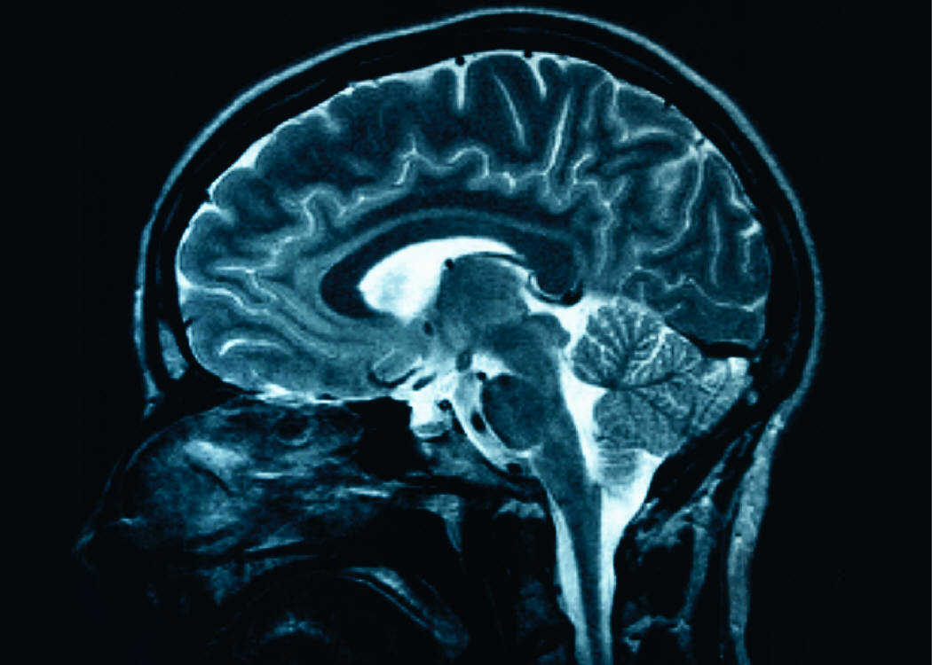
Be Ye Transformed By The Renewing of your Mind
This Photo by Unknown Author is licensed under CC BY-SA

Slide 2
Part 1
Establishing the basics
Romans 12 v 2
And do not be conformed to this world, but be transformed by the renewing of your mind, that you may prove what is that good and acceptable and perfect will of God.

Slide 3
What Does the Bible Say?
Therefore, if anyone is in Christ, he is a new creation; old things have passed away; behold, all things have become new. 2 Cor 5 v 17
And the very God of peace sanctify you wholly; and I pray God your whole spirit and soul and body be preserved blameless unto the coming of our Lord Jesus Christ 1 Thess 5.23

Slide 4
1 Corinthians 15 v 42 -53
v42 It is the same way with the resurrection of the dead. Our earthly bodies are planted in the ground when we die, but they will be raised to live forever. Our bodies are buried in brokenness, but they will be raised in glory. They are buried in weakness, but they will be raised in strength. They are buried as natural human bodies, but they will be raised as spiritual bodies. For just as there are natural bodies, there are also spiritual bodies.
v46 - What comes first is the natural body, then the spiritual body comes later…
v49 - Just as we are now like the earthly man, we will someday be like the heavenly man. What I am saying, dear brothers and sisters, is that our physical bodies cannot inherit the Kingdom of God. These dying bodies cannot inherit what will last forever.
v51 - We will not all die, but we will all be transformed! ….
v53 - For our dying bodies must be transformed into bodies that will never die; our mortal bodies must be transformed into immortal bodies

Slide 5
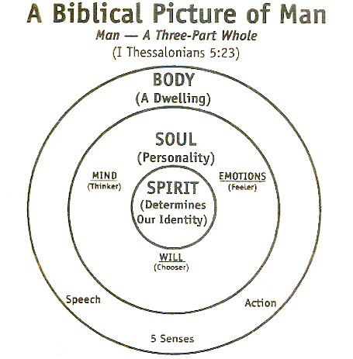

Slide 6
Medical Report:
Life events, stress & Illnesses https://www.ncbi.nlm.nih.gov/pmc/articles/PMC3341916/
Chronic stress has a significant effect on the immune system that ultimately manifest an illness. It raises catecholamine and suppressor T cells levels, which suppress the immune system.
This suppression, in turn raises the risk of viral infection. Stress also leads to the release of histamine, which can trigger severe broncho-constriction in asthmatics. Stress increases the risk for diabetes mellitus, especially in overweight individuals, since psychological stress alters insulin needs.
Stress also alters the acid concentration in the stomach, which can lead to peptic ulcers, stress ulcers or ulcerative colitis.
Chronic stress can also lead to plaque build up in the arteries (atherosclerosis), especially if combined with a high-fat diet and sedentary living.
The correlation between stressful life events and psychiatric illness is stronger than the correlation with medical or physical illness. The relationship of stress with psychiatric illness is strongest in neuroses, which is followed by depression and schizophrenia. There is no scientific evidence of a direct cause-and-effect relationship between the immune system changes and the development of cancer. However, recent studies found a link between stress, tumour development and suppression of natural killer (NK) cells, which is actively involved in preventing metastasis and destroying small metastases.

Slide 7
2 Corinthians
3 v 18
Amplified version
Message Translation
But we all, with unveiled face, beholding as in a mirror the glory of the Lord, are being transformed into the same image from glory to glory, just as by the Spirit of the Lord.
And so we are transfigured much like the Messiah, our lives gradually becoming brighter and more beautiful as God enters our lives and we become like him

Slide 8
Summary
1) We are beings with 3 parts – Spirit, Soul, Body
2) The bible says our spirits are brand new creations at salvation, our bodies will be brand new when Jesus comes for His church at the harpazo, but our souls – our minds – are in a process of being saved or renewed
3) The renewing of the mind is a process which we are commanded to undertake. It is the next step in becoming a mature Christian.
4) The mind has a direct impact on the body. Our thoughts influence our bodies directly because the body interprets the messages coming from the brain to prepare us for whatever is expected. Our mental, emotional and physical health are affected by our mind!
5) Those who are called “more than conquerors” are those who can withstand any situation yet stand strong in His love. We can only do this if we have renewed our minds. The BATTLE IS IN THE MIND

Slide 9

HOMEWORK
READ – the scriptures. Meditate on them, confess them, understand them, memorise them
PRAY – over what you have heard, and what is to come
PREPARE – prepare yourself for the coming weeks by keeping these things in the forefront of your heart. Prepare to build upon this foundation and take the next steps in God’s plan and will for your life.
SUBMIT- submit to the word of God. Submit to God and His will to transform you into His likeness.
ACCOUNTABILITY – A good way to succeed is to make yourself accountable. First and foremost, to God. Secondly to someone you trust.
From the heart of God : 1 Thess 5 v 11: “Therefore encourage one another and build one another up”
“Iron sharpens iron “

Slide 10
Key Scriptures
Romans 12 v 2
1 Corinthians 15 v 42 -53
2 Cor 3 v 18
Romans 8 v 35 -39

